Slide 1


AirVoyager – Airline reservation system for DBMS using MySQL
Spandan Sahai (RA2311026010918)
Keshat Saini (RA2311026010916)

Slide 2
Problem Statement For AirVoyager
Data Inconsistency Between Booking and Flight Modules
Problem: In some systems, bookings are disconnected from flight data, leading to inconsistency.
Solution: Integrated design where bookings are directly tied to existing flights in the database, ensuring consistent data access.
Security Risks in Authentication
Problem: Many basic websites store passwords in plain text, risking user privacy.
Solution: The login system implements hashed passwords and session-based login for better security.
Manual Ticket Booking Hassles
Problem: In traditional systems, booking flights involves manual data entry, long queues, or agent dependency.
Solution: A fully online, user-driven system that automates booking and boarding pass generation—minimizing human errors and time delays.

Slide 3
Objectives for AirVoyager
To design and implement a secure and user-friendly web-based flight booking system
Allow users to log in, view available flights, and book tickets with real-time flight data.
To automate the boarding pass generation process using dynamic data and barcode integration
Generate personalized boarding passes instantly upon successful booking, reducing manual workload.
To maintain a scalable and normalized backend database for efficient management of flights, users, and city routes
Ensure consistency, quick access, and easy future upgrades of the system architecture.

Slide 4
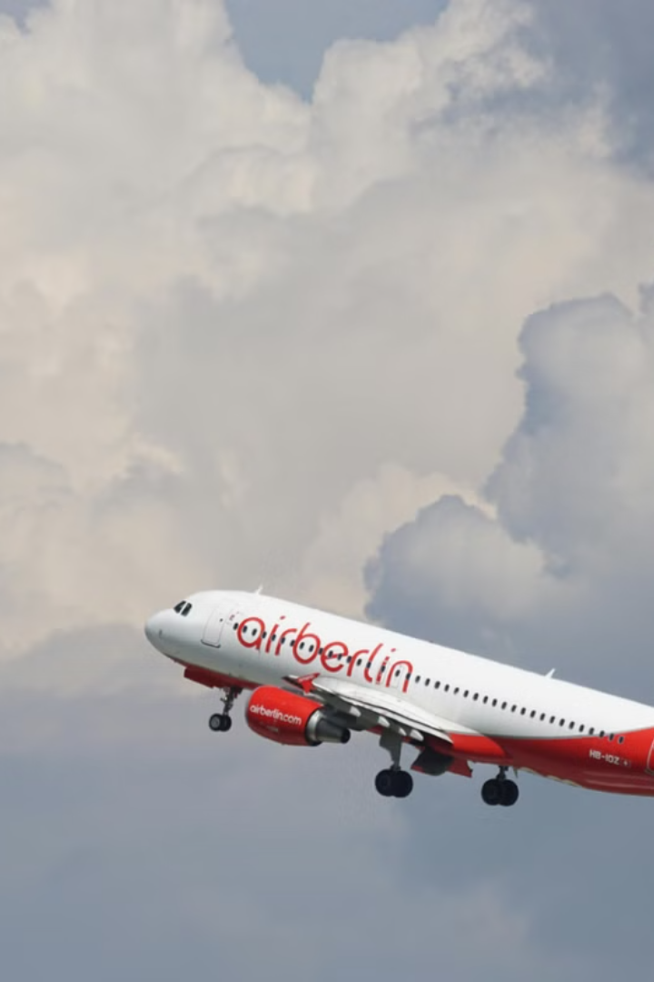
Introduction
In today’s fast-paced digital world, the demand for efficient and hassle-free flight booking systems is higher than ever. This project presents a dynamic web-based flight booking platform that simplifies the entire travel reservation process — from browsing flights to generating boarding passes. Built using PHP, MySQL, and integrated with Python-based real-time flight data updating, the system focuses on user convenience, secure authentication, and automated document generation. By streamlining flight search, ticket booking, and boarding pass creation, this project addresses key inefficiencies in traditional booking methods and sets the stage for smarter travel solutions.
We can solve the major issues in traditional flight booking systems by using databases.

Slide 5
Identification Of Entities
User
Represents the person accessing the system to book flights.
Stores credentials like username and password for login and authentication.
Flight
Represents an available flight that users can book.
Includes attributes like flight_id, source, destination, departure_time, arrival_time, price, and seats_available.
Booking
Represents a ticket reservation made by a user for a specific flight.
Links a user to a flight and includes details like booking_id, passenger_name, email, seat_number, and date.
Boarding Pass
Represents the document generated after successful booking.
Contains booking_id, flight details, passenger info, and a barcode for check-in.
City
Represents the source and destination cities for flights.
Attributes include city_id and city_name.

Slide 6
Identification of Relationships
Books (between User and Booking)
A User can make multiple Bookings.
Each Booking is associated with one User.
This is a one-to-many relationship.
Assigned_To (between Booking and Flight)
Each Booking is assigned to one Flight.
A Flight can have multiple Bookings.
This is a many-to-one relationship.
Operates_From / Operates_To (between Flight and City)
A Flight originates from one City and arrives at another City.
Each City can be the source or destination for multiple Flights.
This is a many-to-one relationship (from Flight to City).
Generates (between Booking and Boarding Pass)
Each Booking generates one Boarding Pass.
Each Boarding Pass is linked to one Booking.
This is a one-to-one relationship.

Slide 7
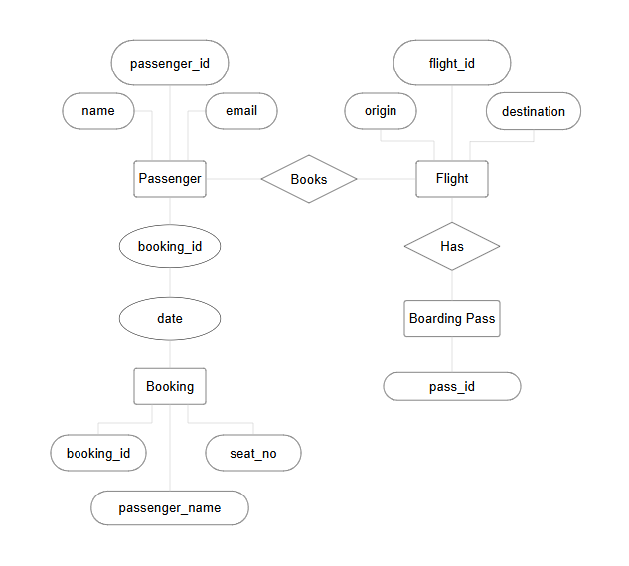
Entity Relationship Diagram

Slide 8



Novelty
Scalability & Future Expansion
1
Designed to accommodate future enhancements, such as multi-city bookings, loyalty programs, and AI-powered recommendations.
Secure & User-Friendly Interface
2
Ensures safe transactions with an intuitive HTML, CSS, and JavaScript UI.
Efficient Database Management
3
Uses MySQL for structured and relational data handling.

Slide 9
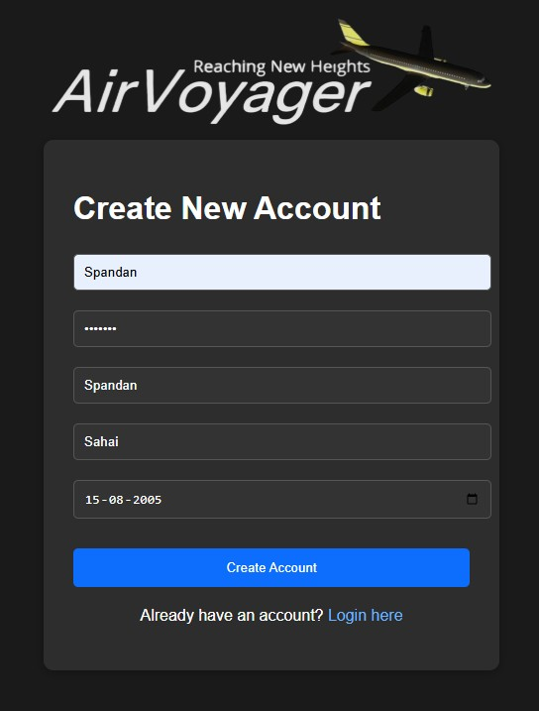
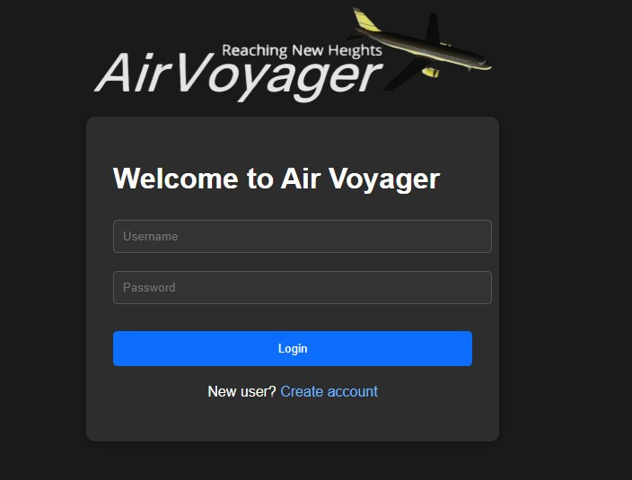
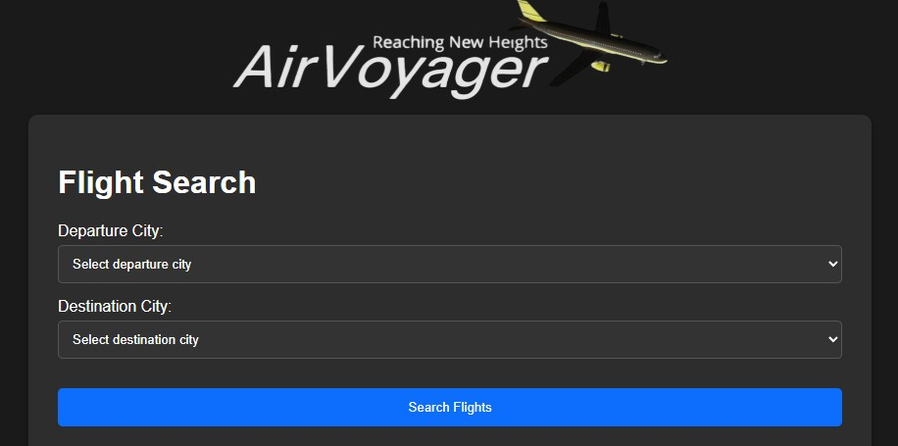
Progress Of AirVoyager

Slide 10
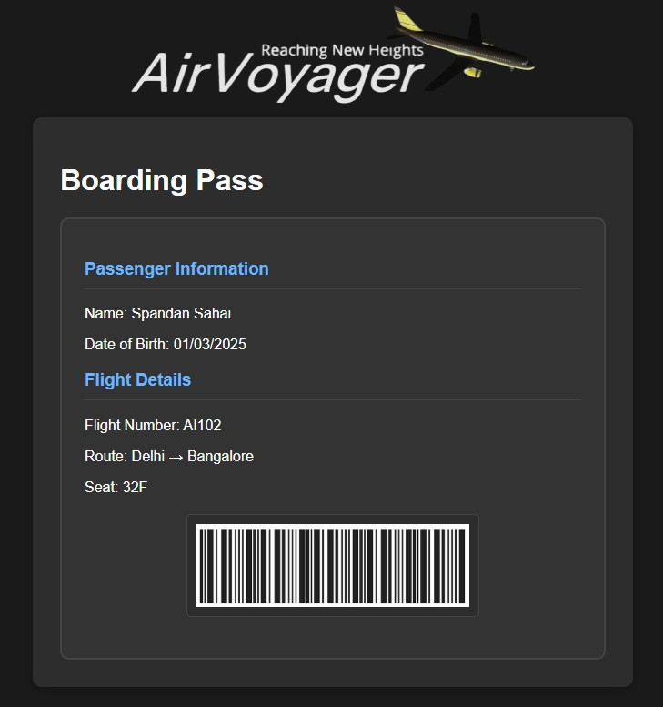
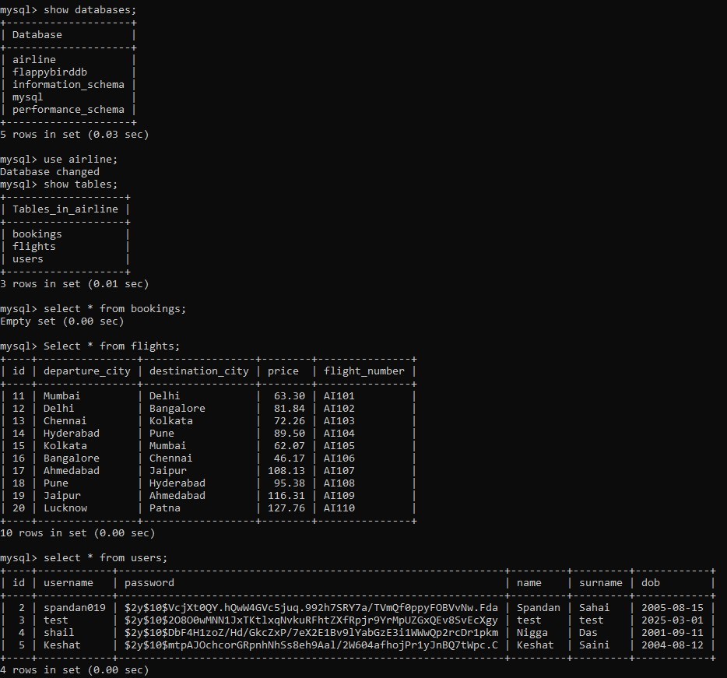
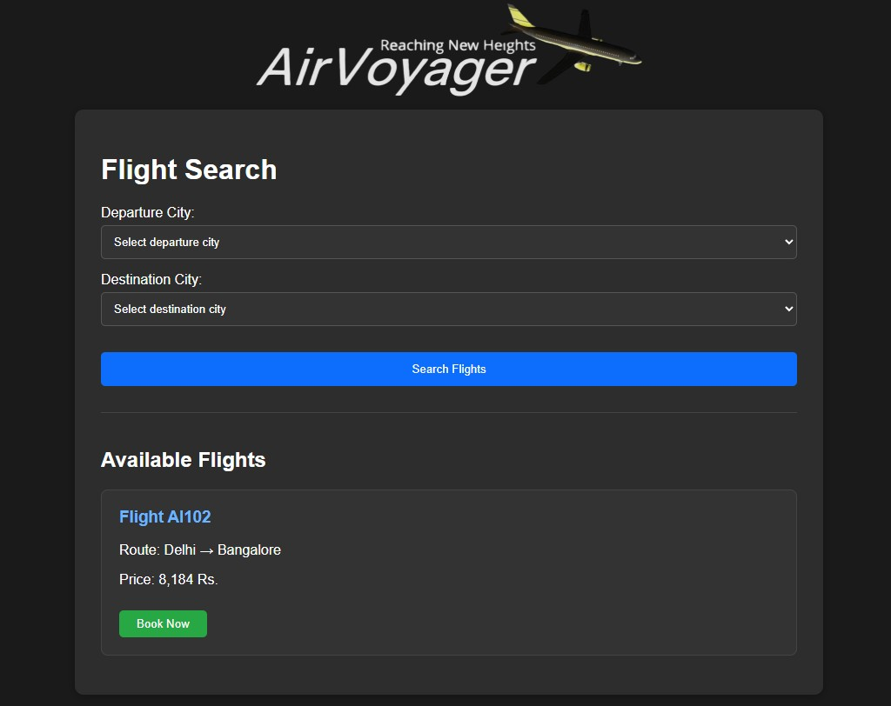
Progress Of AirVoyager

